Slide 1
CSE408 Asymptotic notations
Lecture #4

Slide 2
Asymptotic Notations
The efficiency analysis framework concentrates on the order of growth of an algorithm’s basic operation count as the principal indicator of the algorithm’s
To compare and rank such orders of growth, computer scientists use three notations:(big oh), (big omega), and (big theta)efficiency

Slide 3
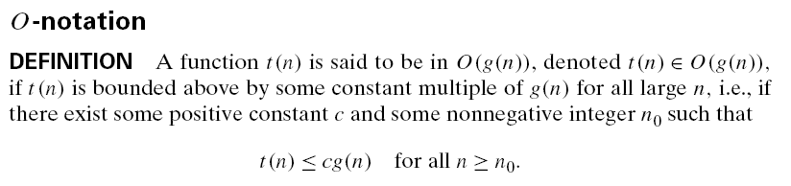
O Notation

Slide 4
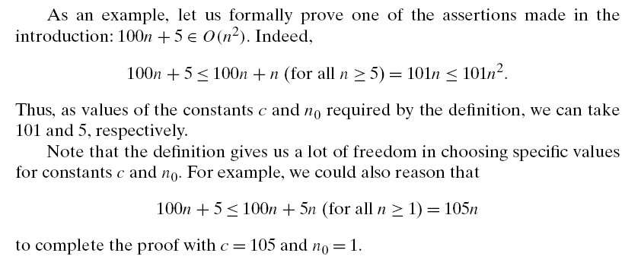
Example

Slide 5
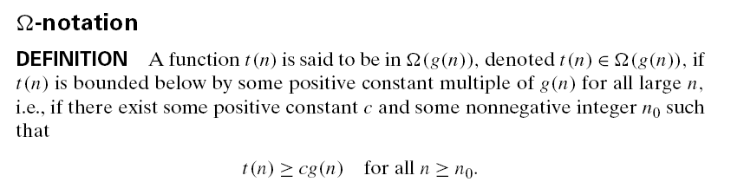
Big omega Notation

Slide 6
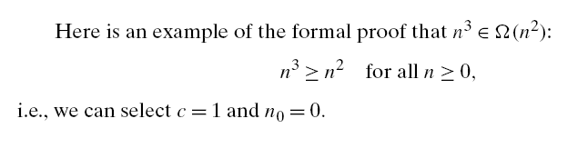
Example

Slide 7
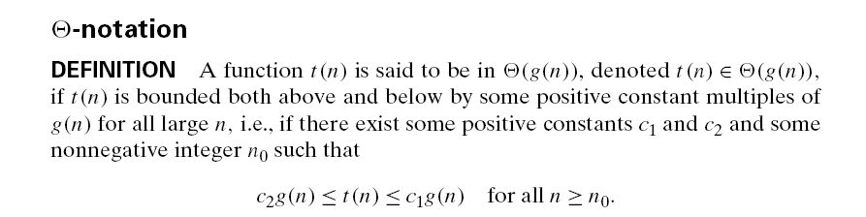
Theta Notation

Slide 8
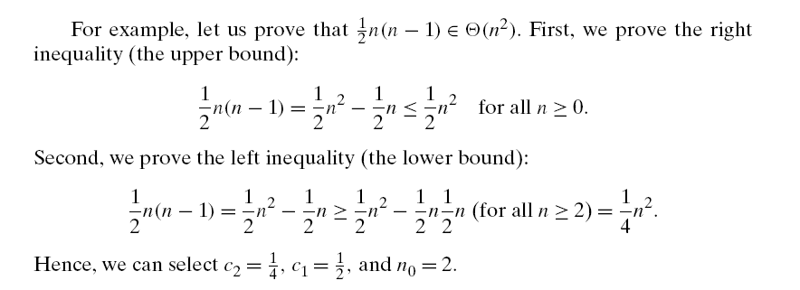
Example

Slide 9
Asymptotic order of growth
A way of comparing functions that ignores constant factors and small input sizes
O(g(n)): class of functions f(n) that grow no faster than g(n)
Θ(g(n)): class of functions f(n) that grow at same rate as g(n)
Ω(g(n)): class of functions f(n) that grow at least as fast as g(n)

Slide 10
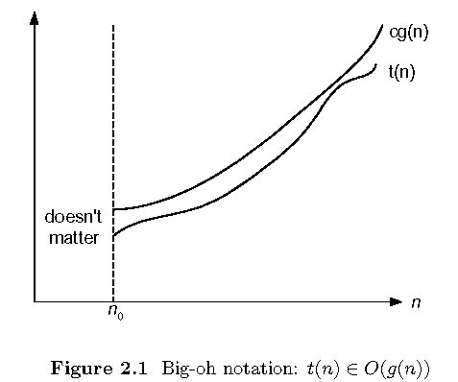
Big-oh

Slide 11
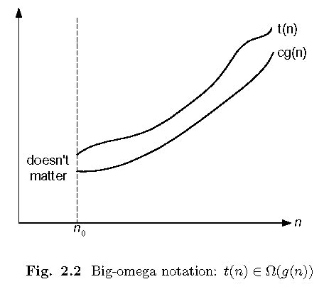
Big-omega

Slide 12
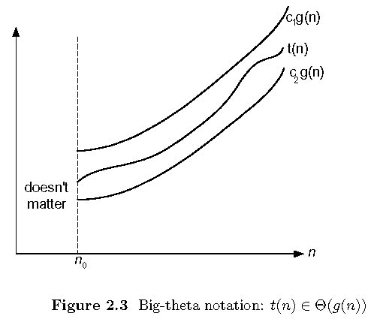
Theta

Slide 13
Some properties of asymptotic order of growth
f(n) ∈ O(f(n))
f(n) ∈ O(g(n)) iff g(n) ∈Ω(f(n))
If f (n) ∈ O(g (n)) and g(n) ∈ O(h(n)) , then f(n) ∈ O(h(n)) Note similarity with a ≤ b
If f₁(n) ∈ O(g₁(n)) and f₂(n) ∈ O(g₂(n)) , then
f₁(n) + f₂(n) ∈ O(max{g₁(n), g₂(n)})

Slide 14
Establishing order of growth using limits
0 order of growth of T(n) < order of growth of g(n)
lim T(n)/g(n) =
c > 0 order of growth of T(n) = order of growth of g(n)
n→∞
∞ order of growth of T(n) > order of growth of g(n)
Examples:
10n vs. n²
n(n+1)/2 vs. n²

Slide 15
L’Hôpital’s rule and Stirling’s formula
L’Hôpital’s rule: If lim_{n→∞} f(n) = lim_{n→∞} g(n) = ∞ and
the derivatives f´, g´ exist, then
Stirling’s formula: n! ≈ (2πn)^{1/2} (n/e)^{n}
f(n)
g(n)
f ´(n)
g ´(n)
lim
n→∞
=
lim
n→∞
Example: log n vs. n
Example: 2^{n} vs. n!

Slide 16
Exmaple

Slide 17
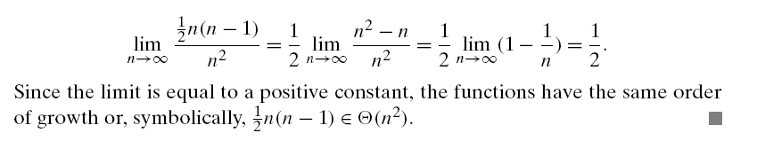
Example

Slide 18
Example

Slide 19
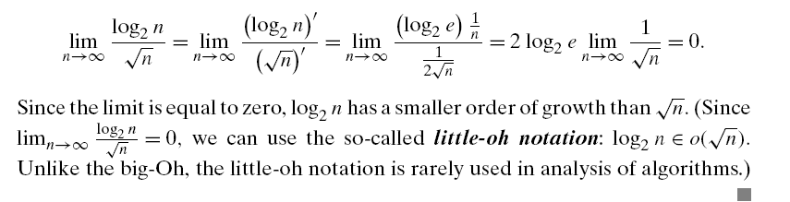
Example

Slide 20
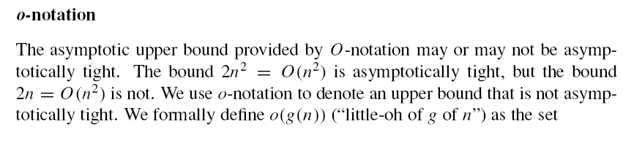
Small Oh Notation

Slide 21
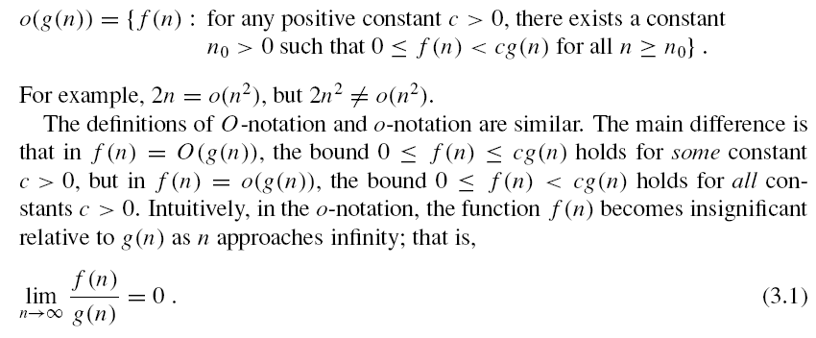
Small Oh Notation

Slide 22
Exmaple

Slide 23
Orders of growth of some important functions
All logarithmic functions log_{a} n belong to the same class Θ(log n) no matter what the logarithm’s base a > 1 is
All polynomials of the same degree k belong to the same class: a_{k}n^{k} + a_{k-1}n^{k-1} + … + a₀ ∈ Θ(n^{k})
Exponential functions a^{n} have different orders of growth for different a’s
order log n < order n^{α} (α>0) < order a^{n} < order n! < order n^{n}

Slide 24
Basic asymptotic efficiency classes
1 | constant
log n | logarithmic
n | linear
n log n | n-log-n
n² | quadratic
n³ | cubic
2^{n} | exponential
n! | factorial

Slide 25
Thank You !!!

